Slide 1
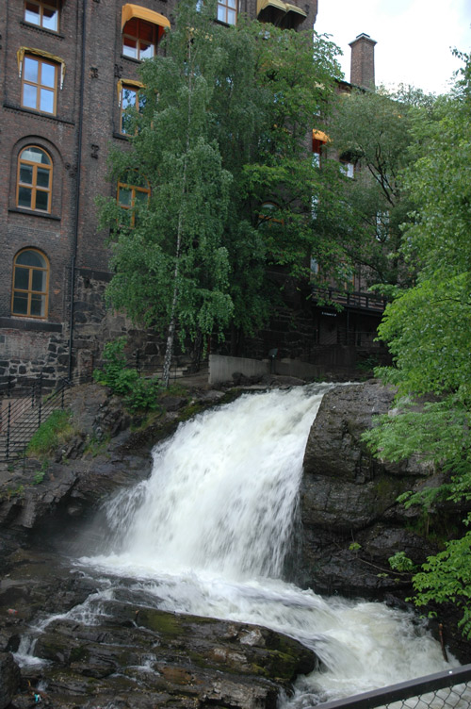
Biophilic City
“…city abundant with nature …that looks for opportunities to repair and restore and creatively insert nature wherever it can. ….[A]n outdoor city, a physically active city, in which residents spend time enjoying the biological magic and wonder around them.”
Timothy Beatley “Biophilic Cities”

Slide 2
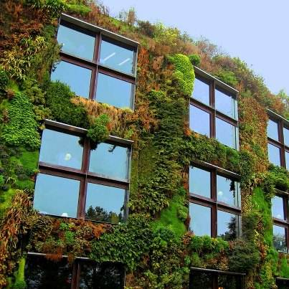
Biophilia
Connect w/nature
Nature Awareness
Support nonhuman species
Farr 2008
sphotos-a.xx.fbcdn.net

Slide 3
Urban Population
World Urbanization Prospects, the 2011 Revision, UN Dept of Economic and Social Affairs

Slide 4
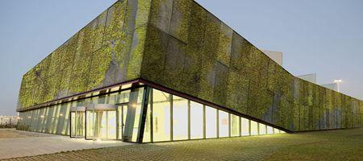
Wildness, not Wilderness
Urban Nature
Human impacted & influenced
Wind & weather
Plants in abandoned Lots
Lichen on buildings
Hawks riding thermals above skyscrapers
Pocket parks
Rooftop gardens
img2.tgdaily.com

Slide 5
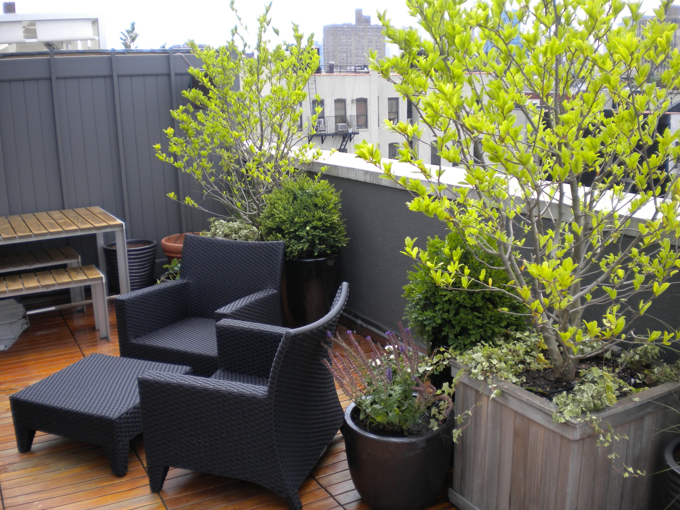
Roof Top Garden
www.koverkrete.com, Jeffrey Erb Landscape Design New York City

Slide 6
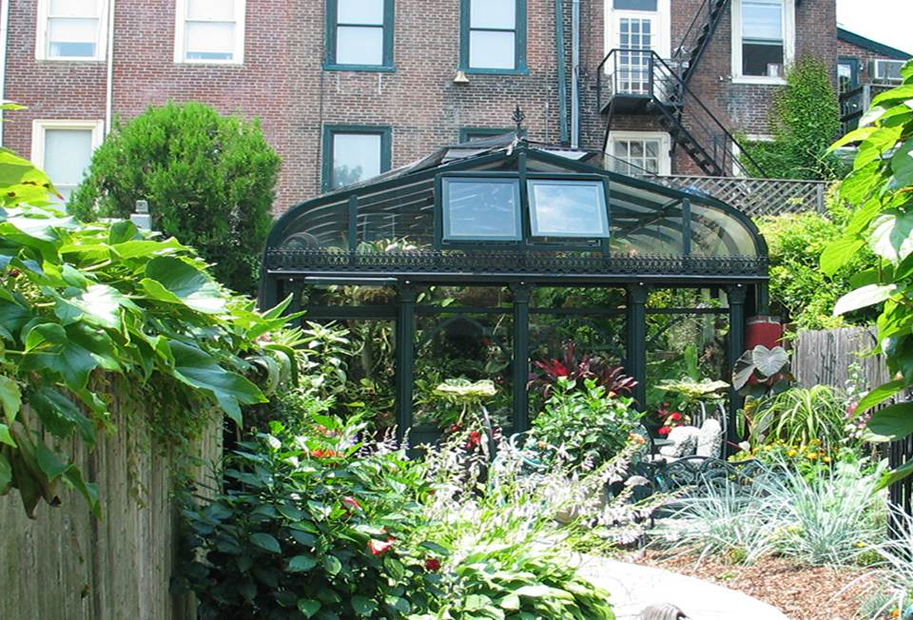
Backyard
solarinnovations.com

Slide 7
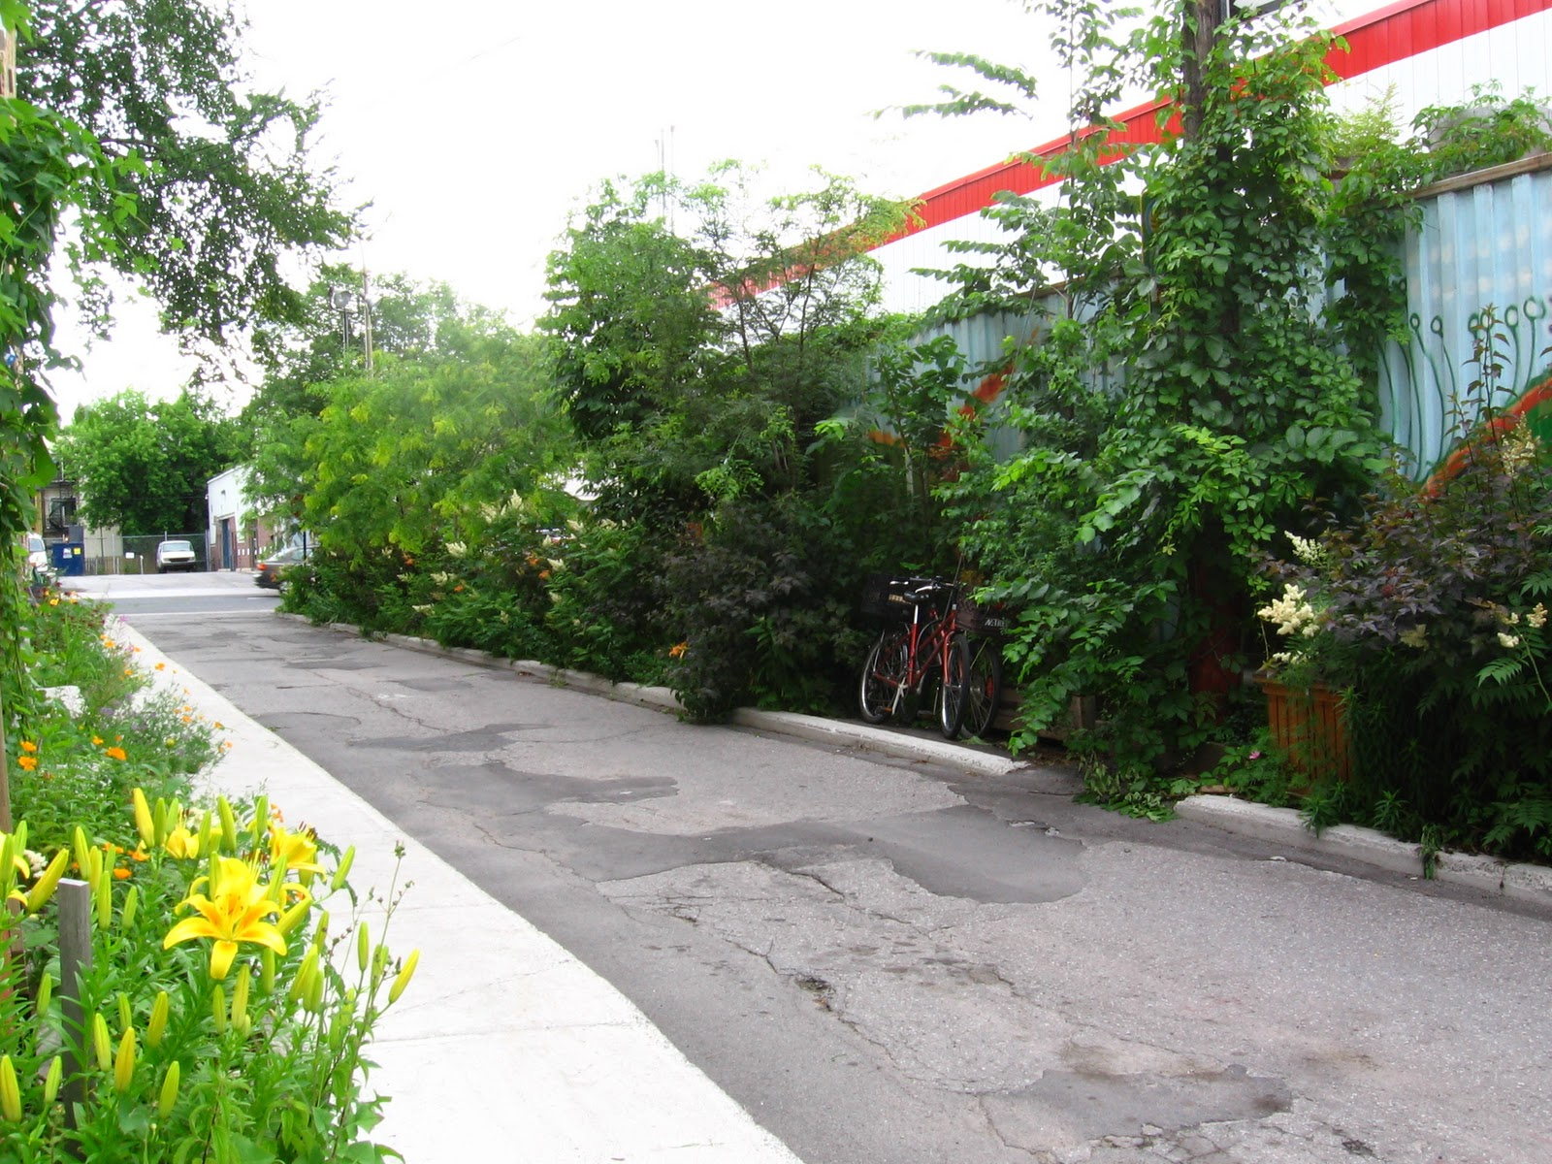
Green Alley, Montreal
osheamontreal.blogspot.com/2012
Notes:
Thanks to Fulbright Canada, I am very excited to announce an award of $4,000 that will help fund a green alley project in the Plateau-Mont Royal neighborhood of Montréal. Neighborhood environmental organization Éco-quartier is developing the green alley in conjunction with a committee of local residents. The project will convert an under-utilized asphalt alley into a public green space that will encourage exercise and socializing among neighborhood residents, while simultaneously improving air quality and reducing urban heat temperatures. I am proud to be part of the project and pleased that I can support the project financially through funding from Fulbright Canada and Royal Bank. The funds will offset the costs of asphalt excavation, purchases of materials, and publicity efforts. Stay tuned for project news as the green alley gets underway later this winter.

Slide 8
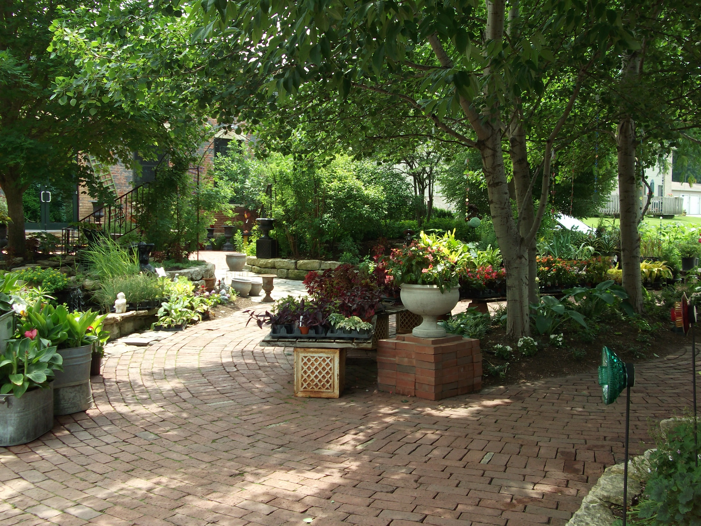
Blumen Gardens, Sycamore, Illinois
Former Abandoned Industrial Lot
fmanos.wordpress.com
Notes:
Blumen Gardens, in Sycamore, Illinois, is one of my all-time favorite nurseries, and my sister Kathy and I were there today. Nestled in the ruins of an abandoned industrial lot, it offers vivid lessons in garden design.

Slide 9
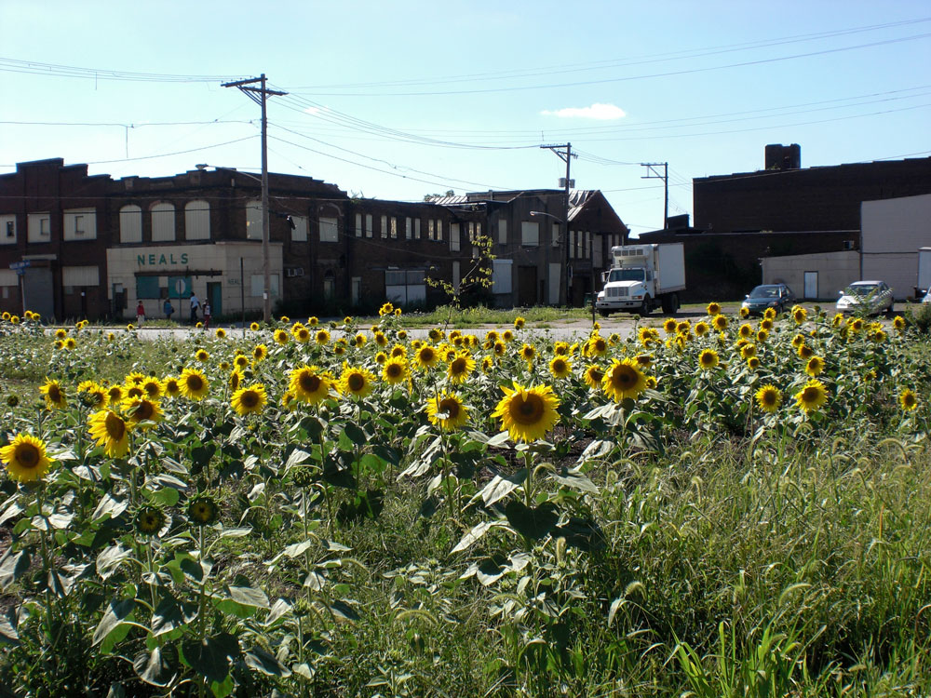
Pittsburg Abandoned Lot
journal.heinz.cmu.edu

Slide 10
Health Benefits
View of trees versus walls
Gall bladder patients recovered faster
Walk in nature versus mall
Improved self esteem & mood, reduce tension
Greenery improves physical & mental health
10 % more green space led to decrease in symptoms comparable to being 5 years younger
Living near park associated with less stress & obesity
Walking/biking daily associated with better health
References cited in Timothy Beatley “Biophilic Cities”

Slide 11
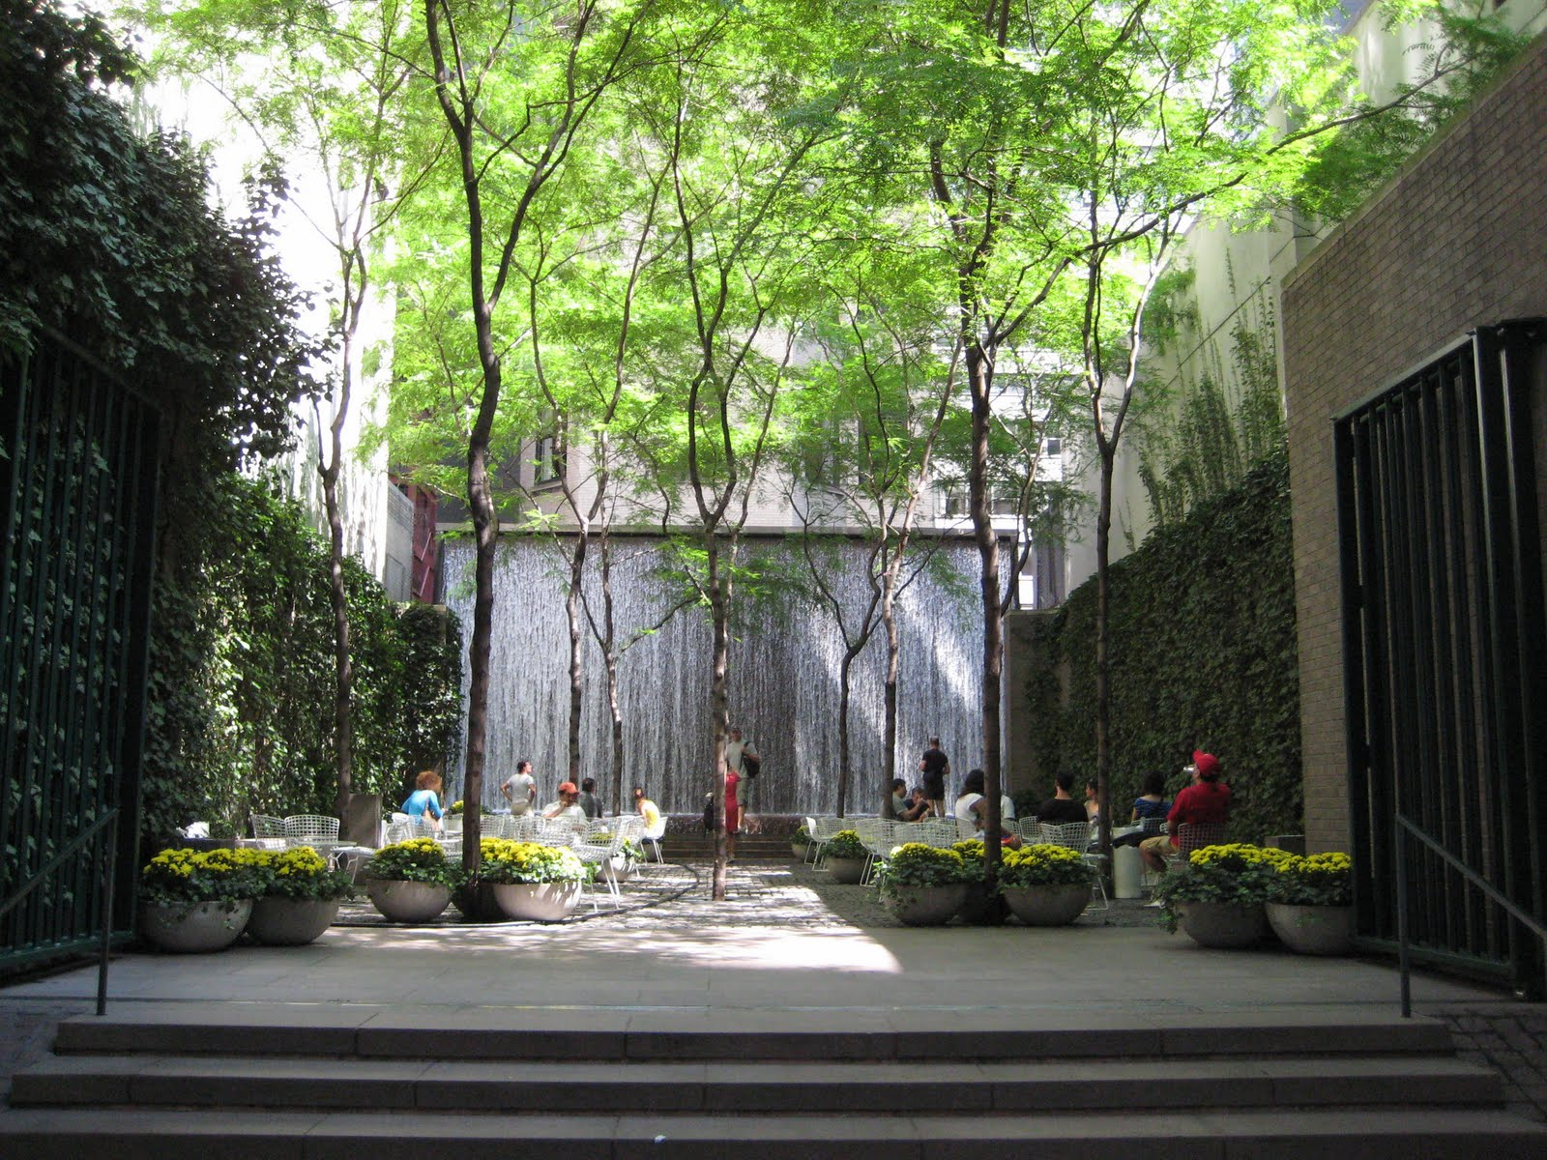
Health Benefits
Cumulative benefits even from brief exposure
Paley Park, NYC, keepsouthbendbeautiful.files.wordpress.com

Slide 12
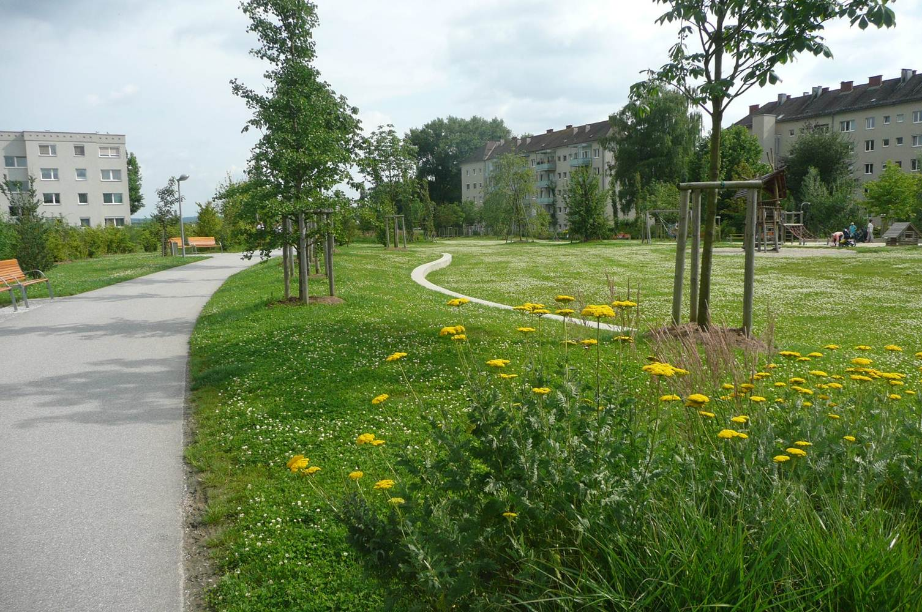
Parks
water.epa.gov

Slide 13
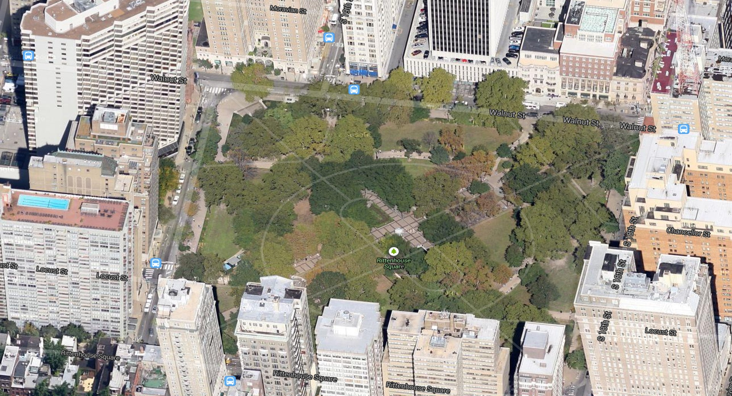
Rittenhouse Square, Philly
Google maps

Slide 14
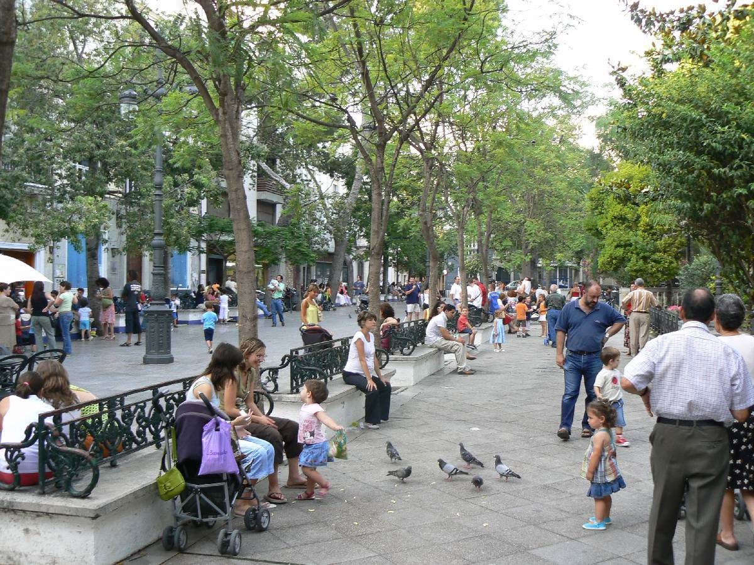
Plaza
Cadiz / gospain.about.com

Slide 15
Environmental Benefits
Heat Island effect reduced
Reduced air pollutants
Sulfur dioxide & particulates
Stormwater Management
Insect Control
References cited in Timothy Beatley “Biophilic Cities”, etc.

Slide 16
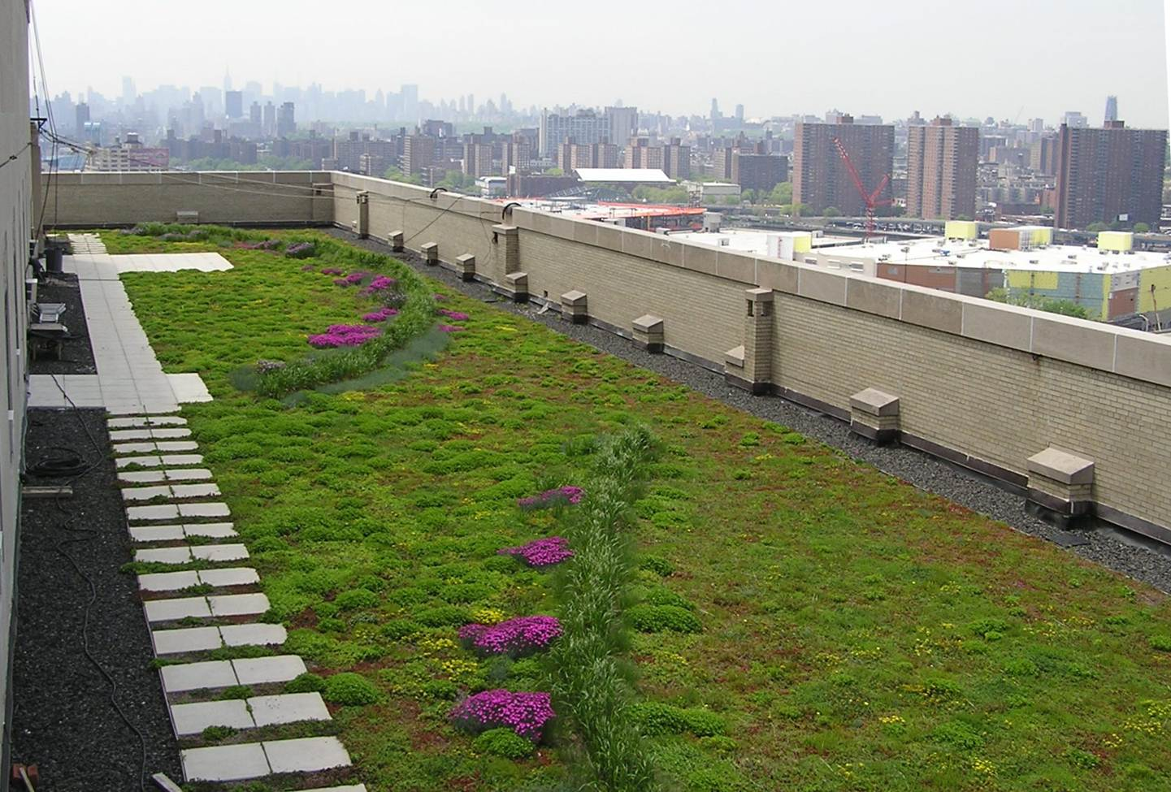
Green Roof
www.bceq.org

Slide 17
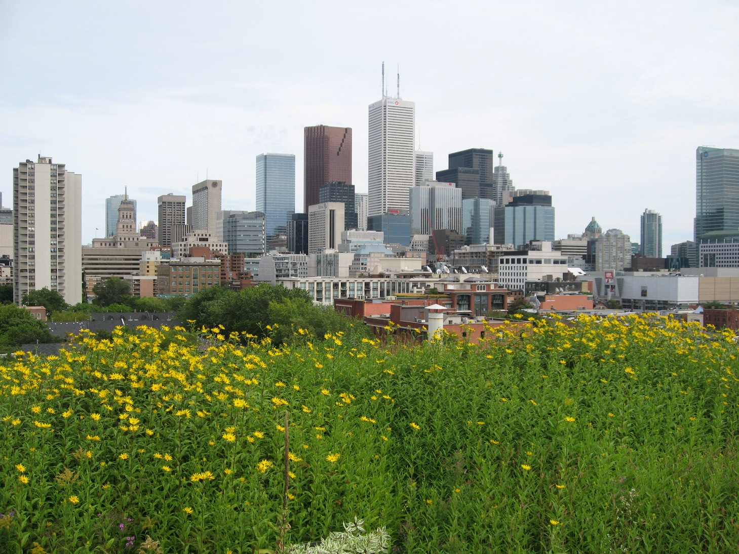
Green Roof, Toronto
www.koverkrete.com

Slide 18
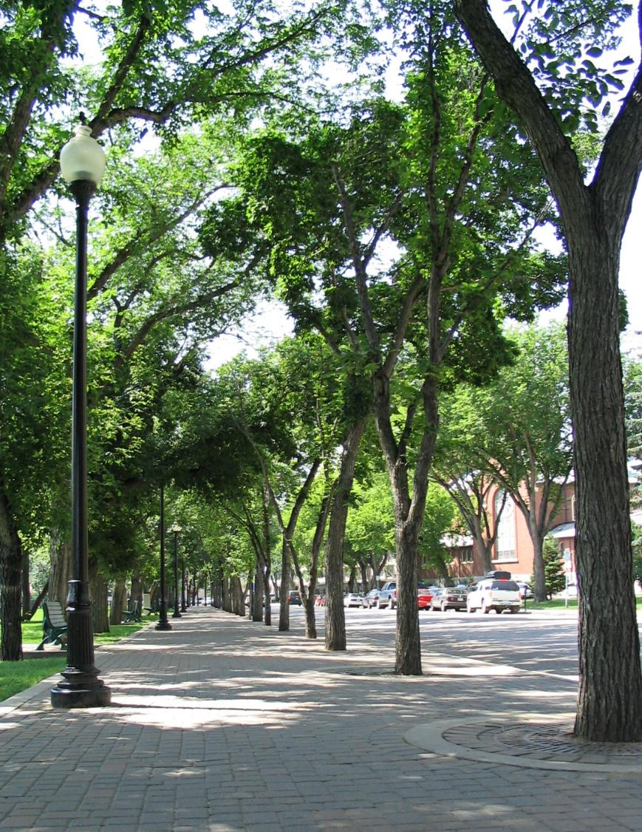
Trees
my.opera.com

Slide 19
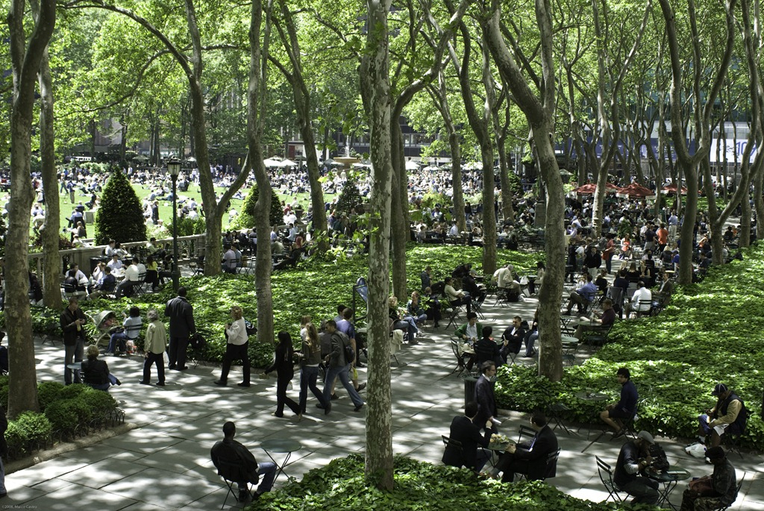
Bryant Park, NYC
www.montanaroue.com

Slide 20
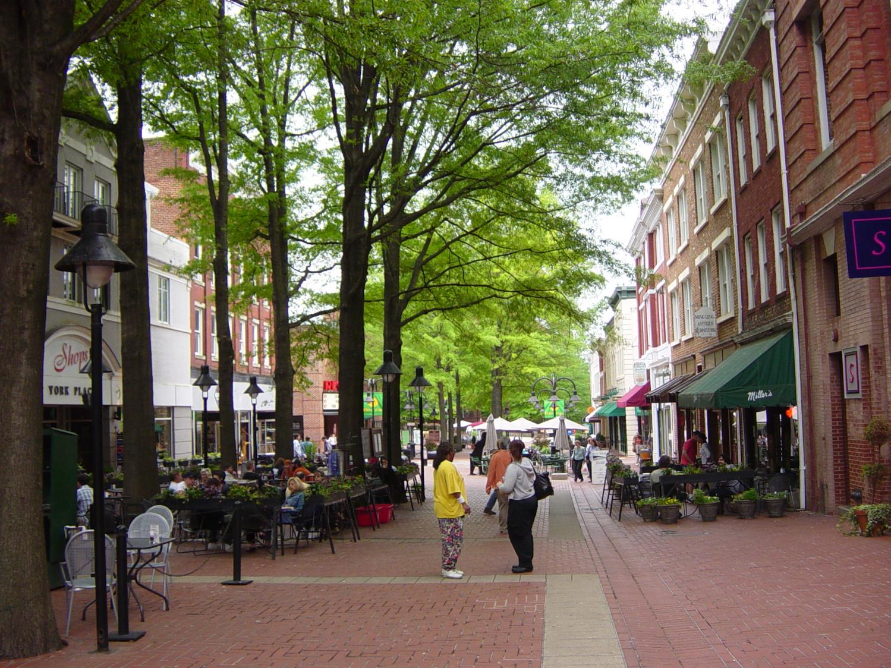
Charlottesville Downtown Mall

Slide 21
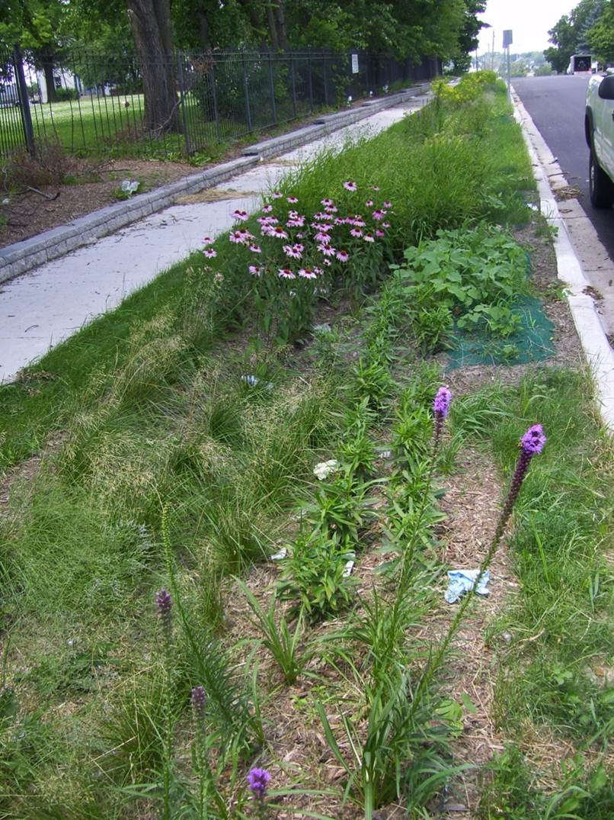
Bioinfiltration Basin Street-Side
encapinc.net

Slide 22
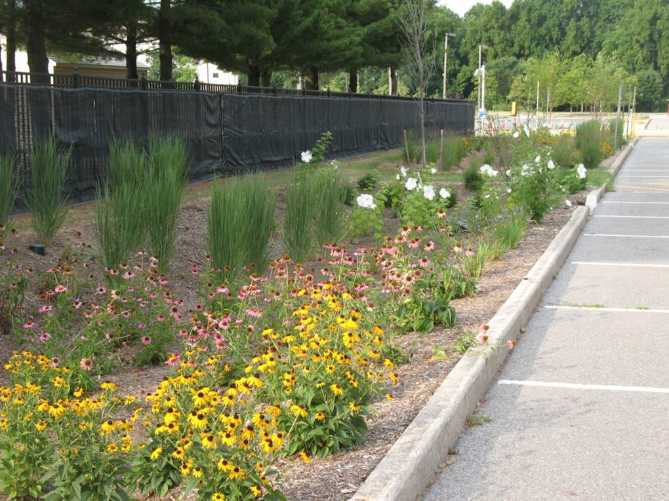
Rowan University - Parking Lot

Slide 23
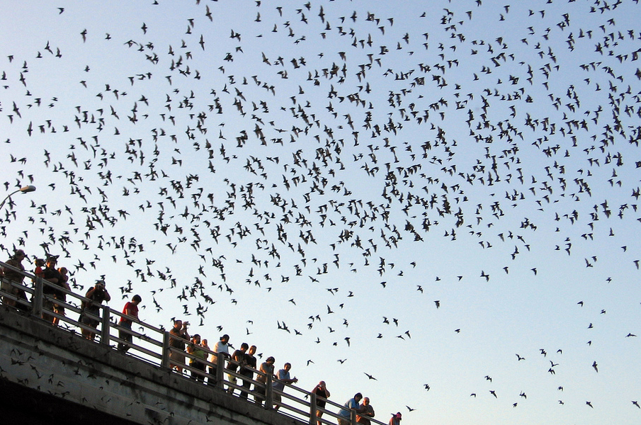
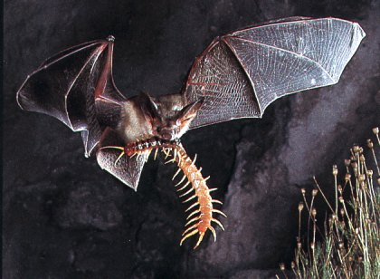
Congress Ave Bridge, Austin TX
1.5 M bats
$10 M tourism
~15,000 lb insects /night
armygalpalhood.files.wordpress.com
www.bird-x.com

Slide 24
Economic Benefits
Daylighting of rivers improves salability
Proximity to green space increases rents
Less costly stormwater management
Tourism
Recreation
Increased use of parks in economic downturns
References cited in Timothy Beatley “Biophilic Cities”

Slide 25
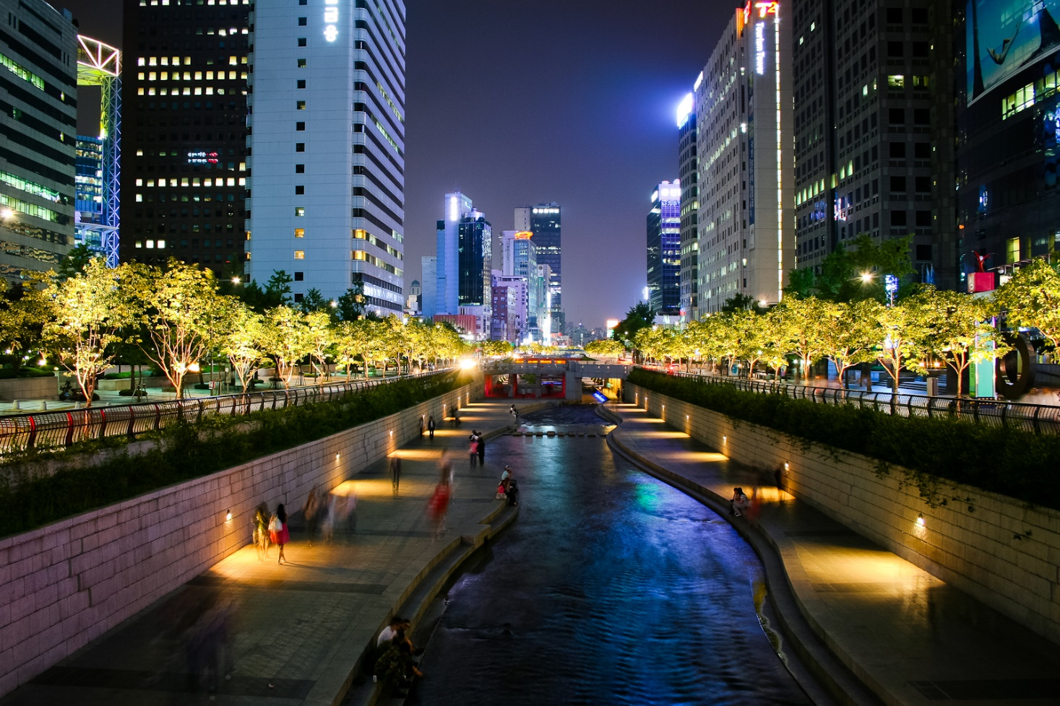
Cheonggycheon River, Seoul, South Korea
In a culvert under a highway until 2005
www.flickr.com

Slide 26
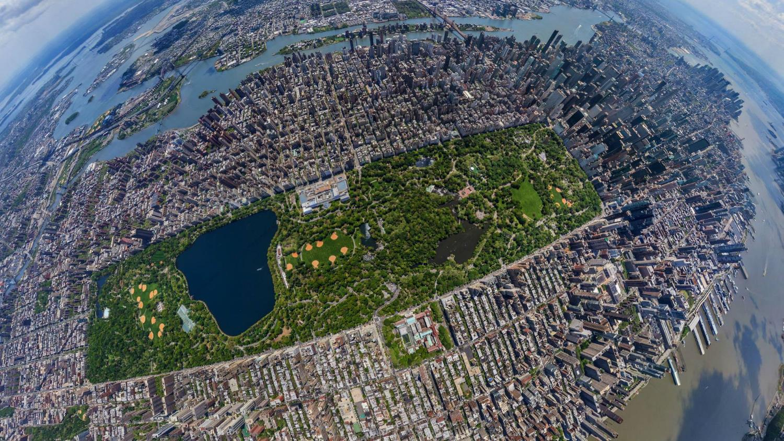
Central Park, NYC
Economic value estimated at $1 B / year
i.imgur.com

Slide 27
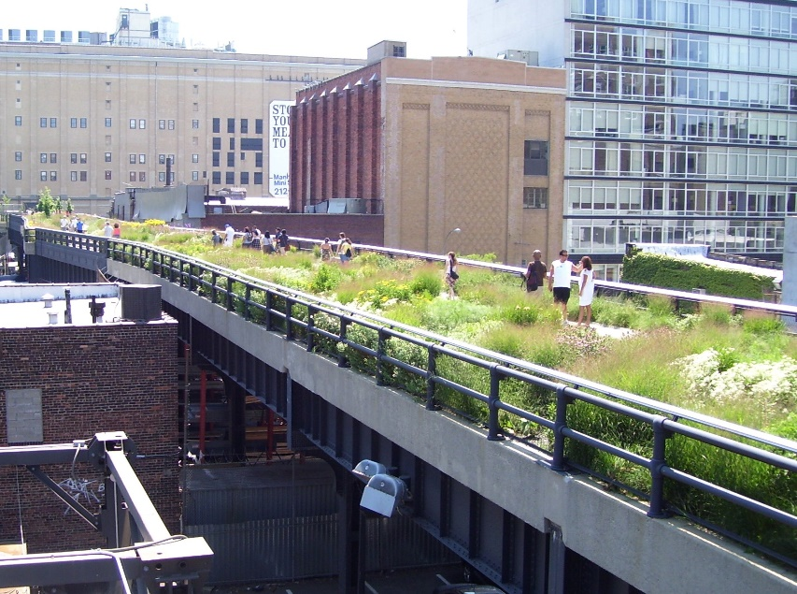
High Line, NYC
1.45 m park on former elevated rail line
upload.wikimedia.org
Stimulated $4 B in private investment
Notes:
Wikipedia
The High Line is a 1-mile (1.6 km)^{[1]} New York City linear park built on a 1.45-mile (2.33 km)^{[2]} section of the elevated former New York Central Railroad spur called the West Side Line, which runs along the lower west side of Manhattan; it has been redesigned and planted as an aerial greenway. A similar project in Paris, the 3-mile (4.8-kilometre) Promenade plantée, completed in 1993, was the inspiration for this project. The High Line currently runs from Gansevoort Street, three blocks below West 14th Street, in the Meatpacking District, to 30th Street, through the neighborhood of Chelsea to the West Side Yard, near the Javits Convention Center. Formerly, the viaduct of the High Line went as far south asCanal Street (where the entrance to the Holland Tunnel is now), but the lower section was demolished in 1960.^{[3]}

Slide 28
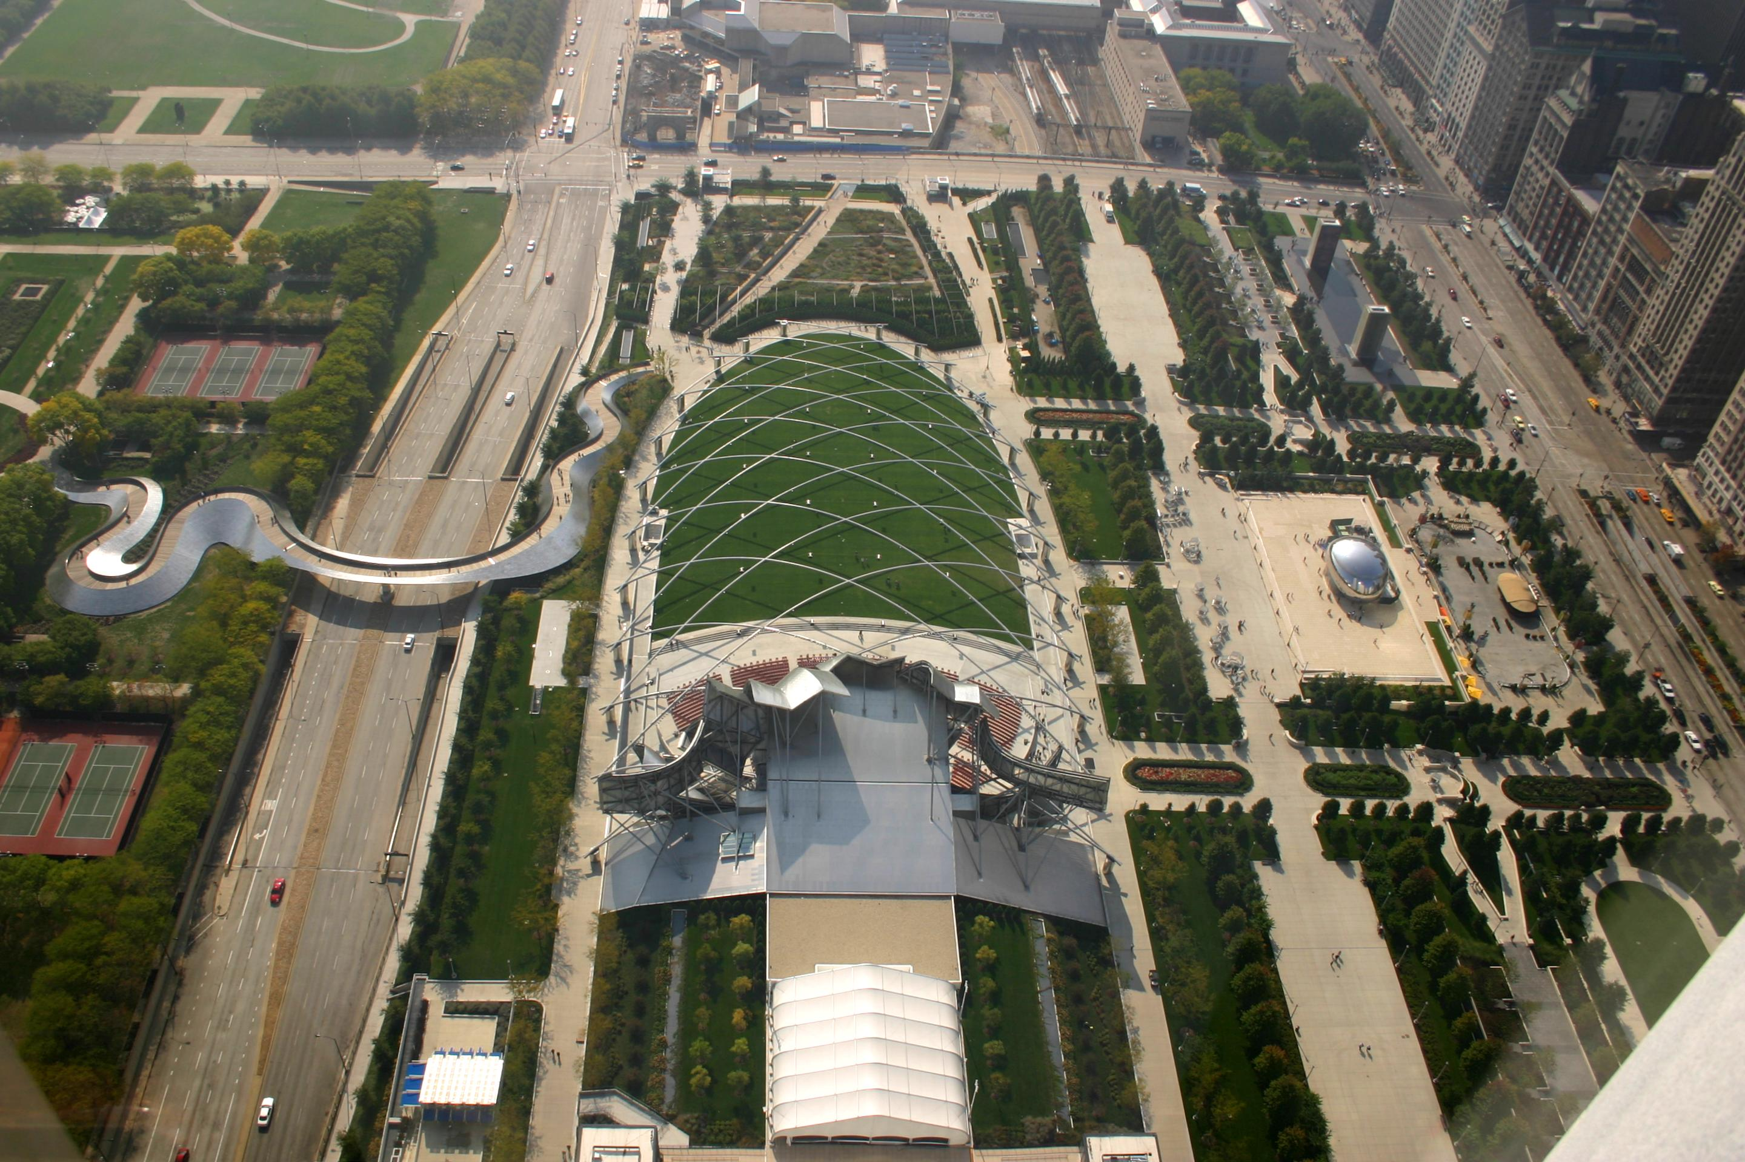
Millenium Park, Chicago
24.5 acres, previousl parkland, Illinois Central rail yards, & parking lots
upload.wikimedia.org
Notes:
Wikipedia
Millennium Park is a public park located in the Loop community area of Chicago in Illinois, USA and originally intended to celebrate the millennium. It is a prominent civic center near the city's Lake Michigan shoreline that covers a 24.5-acre (99,000 m²) section of northwestern Grant Park. The area was previously occupied by parkland, Illinois Central rail yards, and parking lots.^{[1]} The park, which is bounded by Michigan Avenue, Randolph Street, Columbus Drive and East Monroe Drive, features a variety of public art. As of 2009, Millennium Park trailed only Navy Pier as a Chicago tourist attraction.^{[2]}

Slide 29
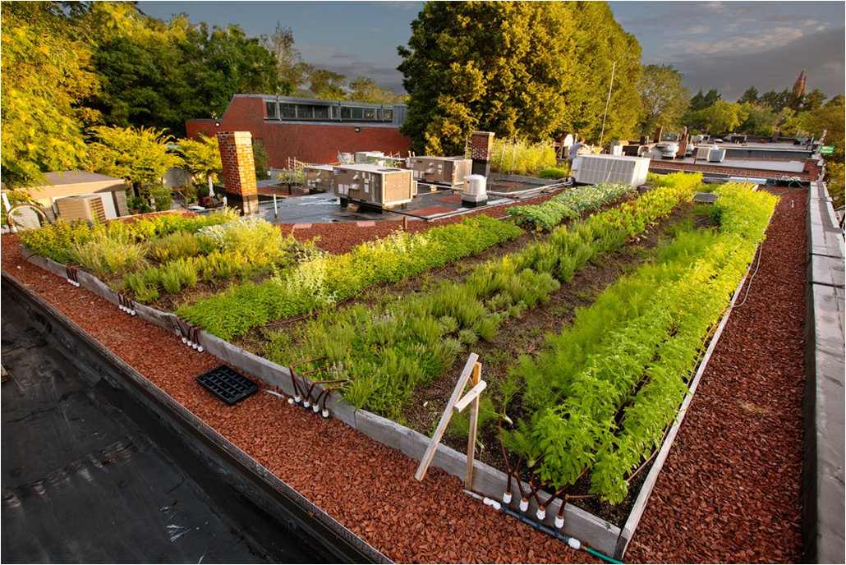
Roof Top “Farm”
growmycitygreen.com
Patrick Rogers Photography
Notes:
Fresh Vegetables Grown Right on Your Roof
Green City Growers installs urban farms high and low, including on rooftops! Rooftops have great potential to grow food for the bustling communities below, and in an ever-crowded world, why not utilize the abundant horizontal space right above our heads?
Green roofs have benefits beyond the potential to grow fresh vegetables: they retain stormwater runoff, create cooler microclimates, reduce buildings’ heating and cooling costs, filter pollutants, and extend the life of a roof.
Green City Growers installs and maintains many rooftop farms throughout the Greater Boston Area. These include Ledge Kitchen and Drink (which just won an award for their rooftop farm) in Dorchester, B.good’s Washington Street location in Downtown Boston, and Flatbread in Somerville, and more recently, Whole Foods in Lynnfield, MA.
With gardens in such close vicinity, chefs are inspired to make seasonal dishes seasonal dishes with their homegrown ingredients. Check out this video on how B.Good’s uses their garden.

Slide 30
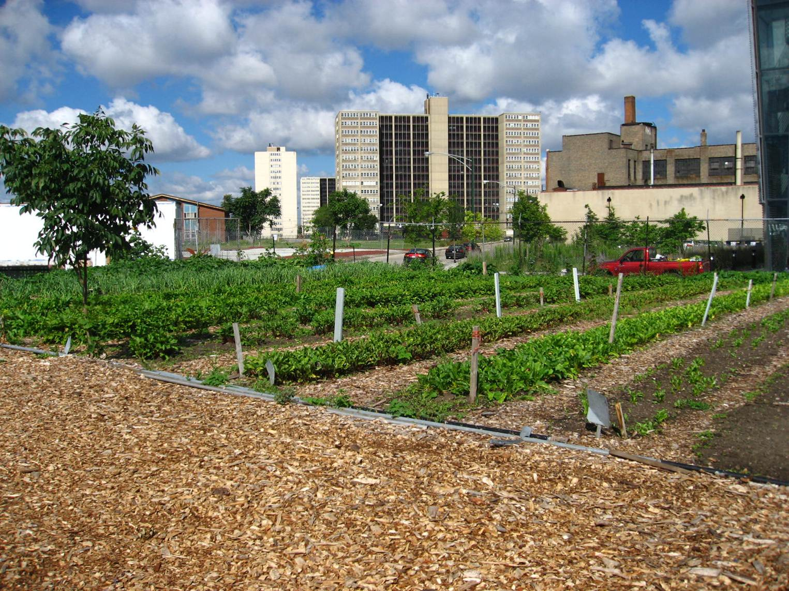
Chicago Urban Garden
upload.wikimedia.org

Slide 31
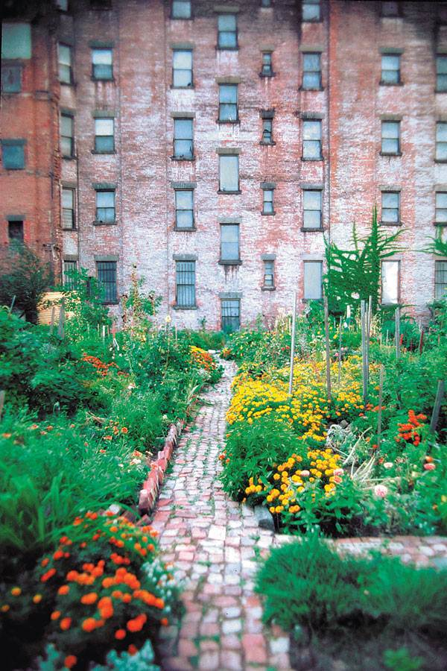
NYC Community Garden
www.morusnyc.org

Slide 32
Raising Children
Heavy media use →
Poor grades, low contentment
Lack of experience with nature →
Alienation, apathy towards nature
Vitamin D deficiency
70 % children / young adults
Need Green space
Free Range or “Feral” Kids
Family time

Slide 33
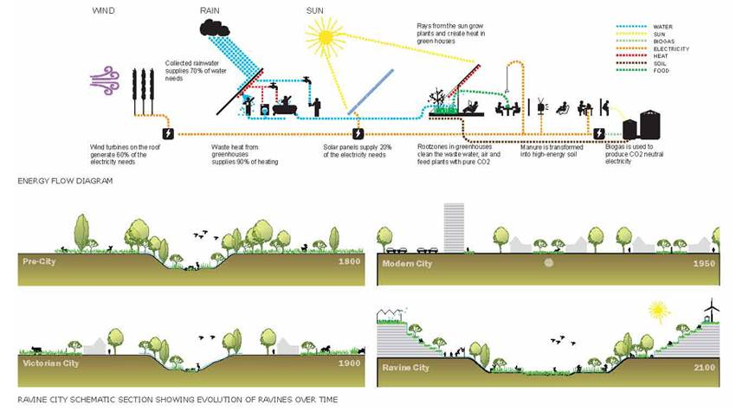
Ravine City Concept – Across Time

Slide 34
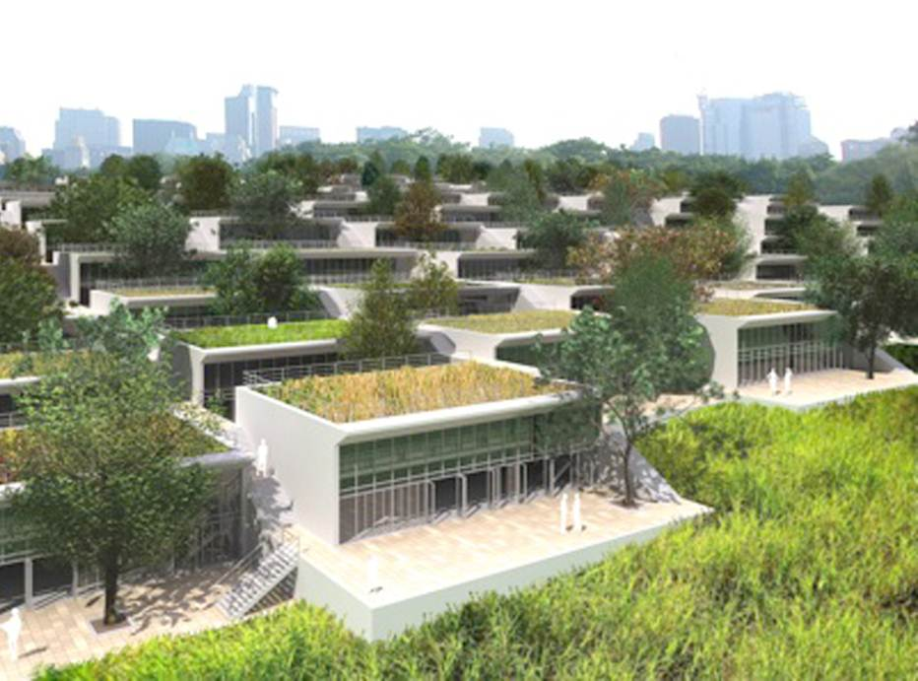
Ravine City Concept - Toronto
www.foodurbanism.org

Slide 35
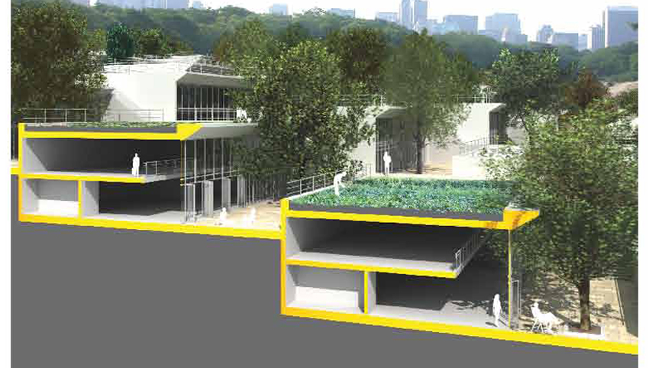
Ravine City Concept – Crops on Roofs

Slide 36
Indicators - Infrastructure
Timothy Beatley “Biophilic Cities” (Suggested values)

Slide 37
Indicators - Activity
Timothy Beatley “Biophilic Cities” (Suggested values)

Slide 38
Indicators – Attitudes & Knowledge
Timothy Beatley “Biophilic Cities” (Suggested values)

Slide 39
Indicators – Institutions
Timothy Beatley “Biophilic Cities” (Suggested values)

Slide 40
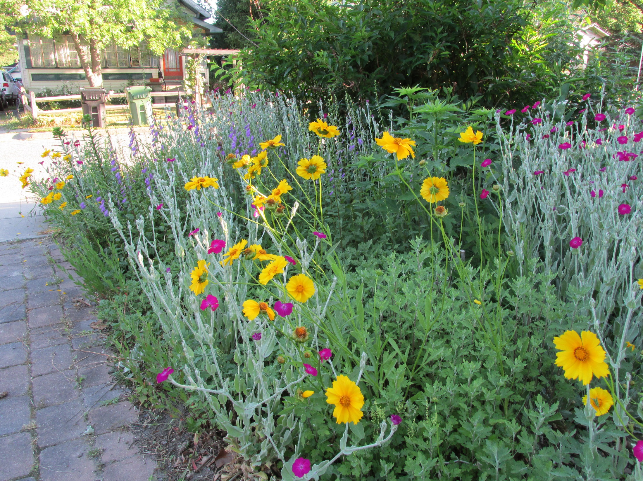

Slide 41
